Slide 1
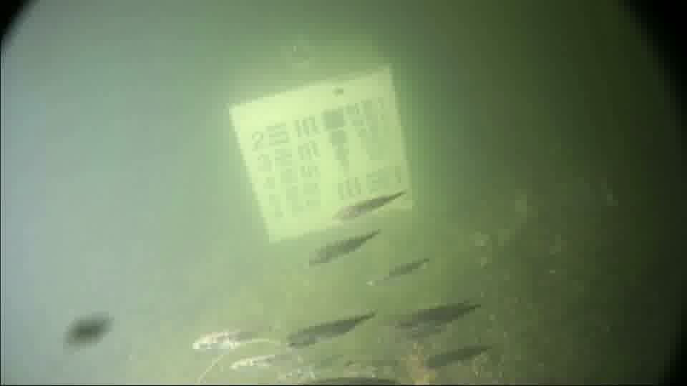
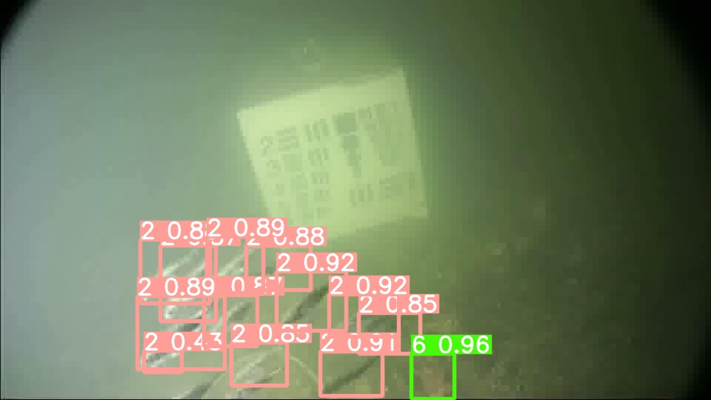
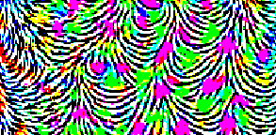

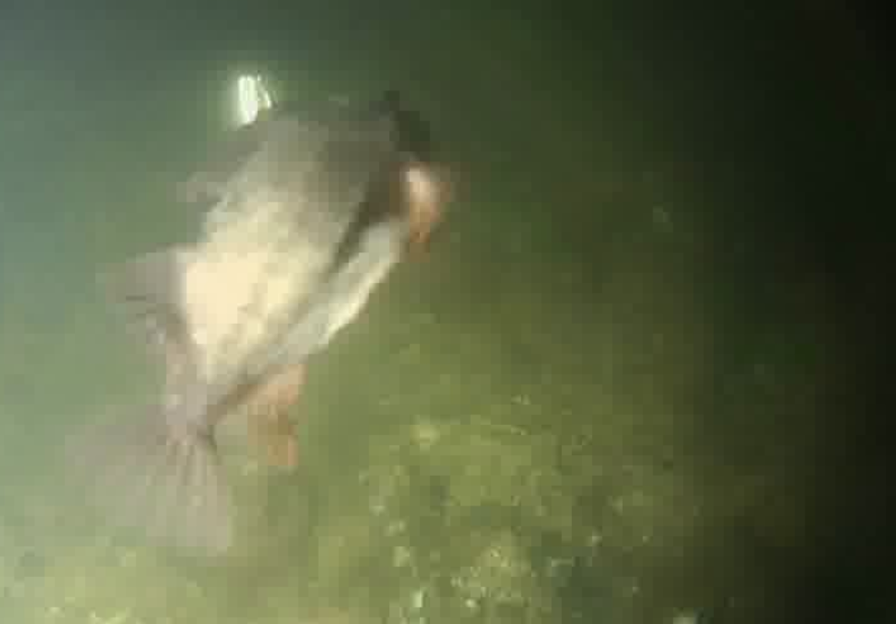
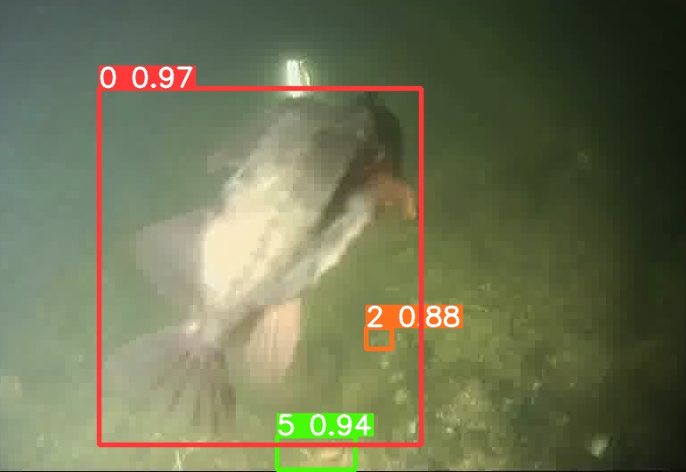
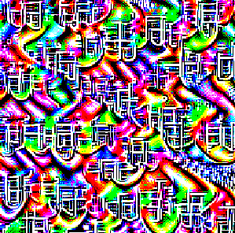
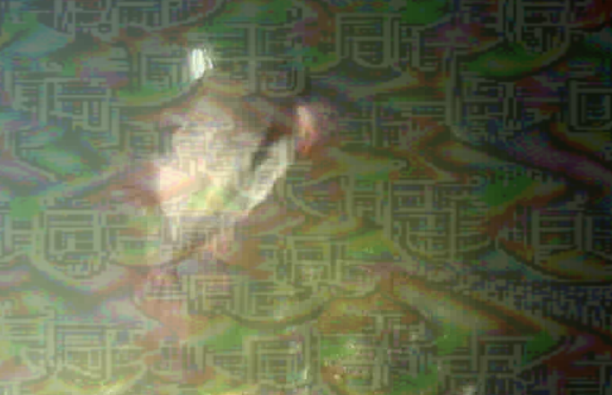
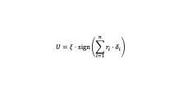
Original Image | Ground Truth Label | Proposed EfficientDet Prediction | Prediction Label before UAP Attack | Prediction Score before UAP Attack | UAP Noise raw pixels | Ground truth Image after UAP attack | Proposed EfficientDet prediction after UAP attack | Prediction Label after UAP Attack | Prediction Score after UAP Attack | Proposed EfficientDet prediction after UAP attack with AL | Prediction Label after UAP Attack with AL | Prediction Score after UAP Attack with AL
 | “Fish-School” |  | “Fish-School” | 92.00% |  |  |  | “Crab” | 96.00% |  | “Fish-School” | 89.00%
 | “Fish-Big” |  | “Fish-Big” | 97.00% |  |  |  | No Prediction | NA |  | “Fish-Big” | 93.00%
$$U=ξ⋅\text{sign}\left(\sum_{i=1}^{n}{r_{i}}⋅δ_{i}\right)$$

